Slide 1




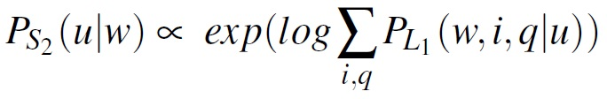
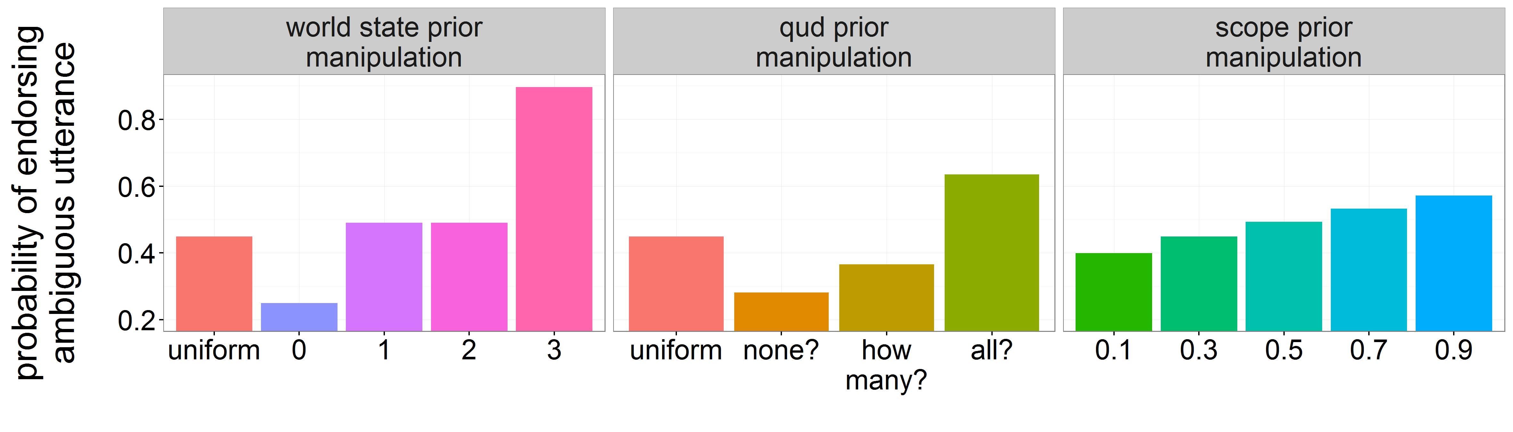
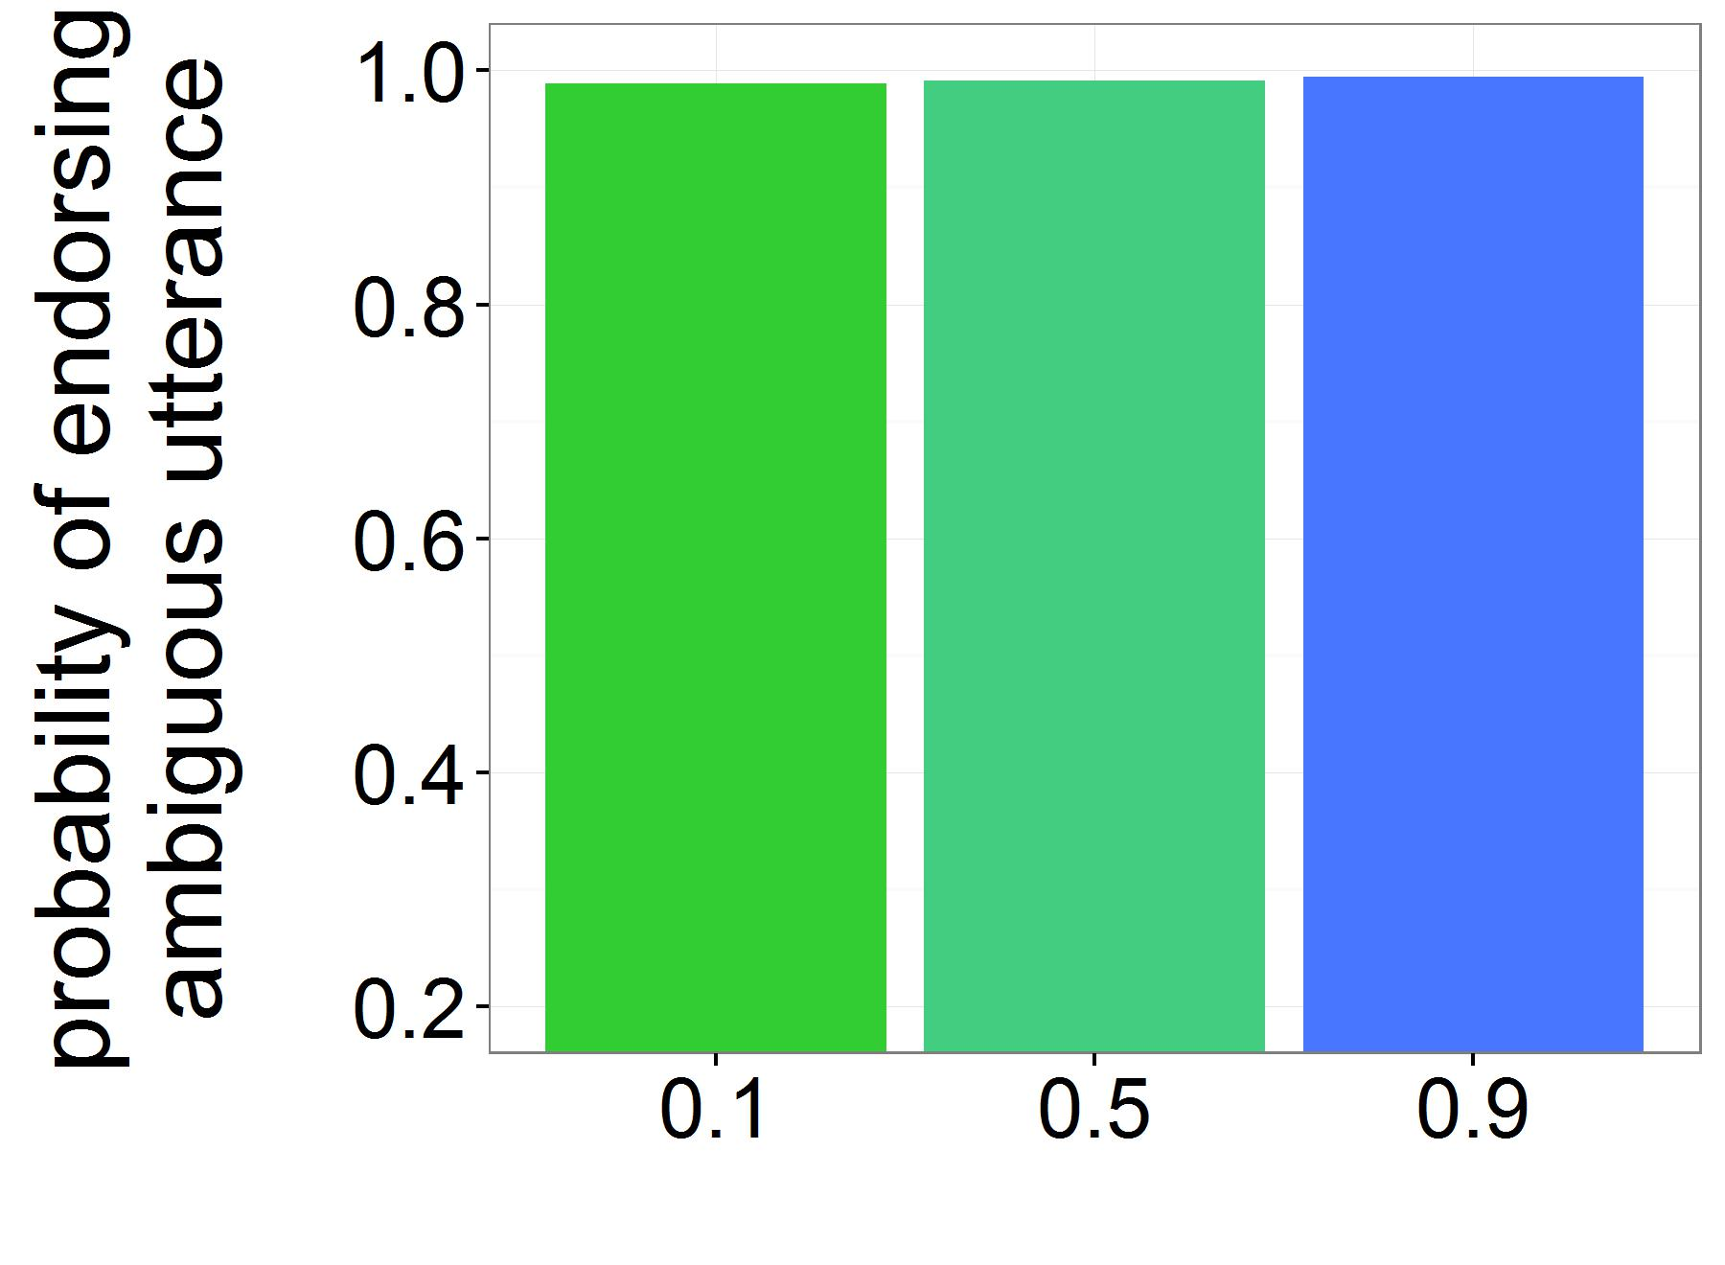


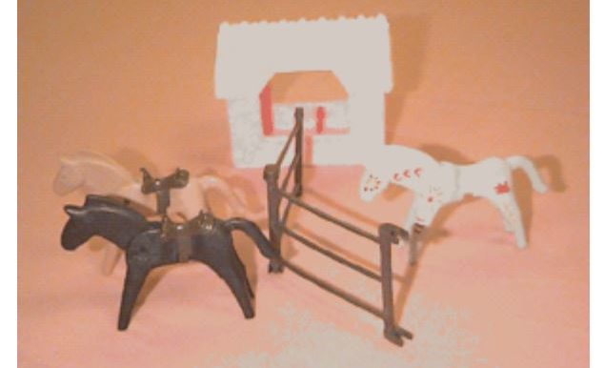
Context management vs. grammatical processing
in children’s scope ambiguity resolution
K.J. Savinelli, Gregory Scontras, and Lisa Pearl
University of California, Irvine
Introduction
Experimental Manipulations
Default Values:
P(w) = uniform
P(q) = uniform
P(surface) = 0.7
P(inverse)=0.3
Manipulated values:
P(w=favored) = 0.9
P(w=unfavored) = 0.1/3
P(q=favored) = 0.9
P(q=unfavored) = 0.05
The linguistic phenomenon: scope ambiguity
“Pragmatic” manipulations
Children struggle to access inverse (not-all) scope interpretations
Early-success affirmative context ➝ more adult-like behavior
- Either explicitly in the test utterance (Musolino & Lidz, 2006)
Every horse jumped over the log, but
every horse didn’t jump over the fence
- Or previously in the story context (Viau et al., 2010)
the horses succeeded at some earlier task in the story
Increasing salience of specific QUD ➝ more adult-like behavior
- The context suggests the Question-Under-Discussion is whether all of the horses succeed (all?; Gualmini, 2004)
amb: Every horse didn’t jump over the fence.
a. ∀ >> ¬ (surface scope):
None of the horses jumped over the fence.
b. ¬ >> ∀ (inverse scope):
Not all of the horses jumped over the fence.
Adults assign two interpretations to a sentences like (amb)
- Two scope operators: every (∀) and n’t (¬)
- The scope operators interact with each other
- The result of this interaction is a scope ambiguity
Unlike adults, children primarily access only the none interpretation
- They appear to struggle to access the not-all, inverse scope
“Structural priming”
Previous not-all interpretations ➝ more adult-like behavior
- Early-success context leads to increased endorsement
- The increase persists through early-failure contexts
Previous unambiguous not-all interpretations leads to not-all interpretations for amb utterance (i.e., ➝ more adult-like behavior)
Not every horse jumped over the fence…
Every horse didn’t jump over the fence
What’s to blame for the non-adult-like behavior?
Fig 2: Model predictions for S₂ amb utterance endorsement in not-all world state
Two proposed factors from the literature:
- Limited pragmatic context management skills (Gualmini et al., 2008;
Viau et al., 2010)
- Limited grammatical processing resources (Viau et al., 2010)
Consensus: Context management (check), grammatical processing (?)
-We find a stronger role for the pragmatic factors in utterance endorsement
-We see this result more clearly in Fig. 3 where pragmatic factors overwhelm the scope prior manipulation
-Context management
-Grammatical processing
What actually changes?
Our contribution
All of the manipulations above plausibly affect various factors
Processing factor:
- How easy the not-all interpretation is to access (i.e., scope)
Pragmatic factors:
- how likely success is in the world (i.e., world knowledge)
- how likely specific QUDs are (i.e., conversational knowledge)
We identify and separate the contributions of these two factors in an articulated formal model of ambiguity resolution as pragmatic inference to diagnose the impact of grammatical processing
Discussion
Fig 3: Model predictions, favoring P(w=3) and P(QUD=all?).
Scope
manipulation
World manipulation
QUD manipulation
Qualitatively capture expt. results through pragmatic factor manipulation
- early-success context ➝ favoring 3 world state ➝ higher endorsement
- increasing QUD salience ➝ favoring all? ➝ higher endorsement
- unambiguous utterance ➝ favoring all? ➝ higher endorsement
Why do pragmatic factors matter so much? The highest rates of utterance endorsement occur when disambiguation is irrelevant for communication
- If beliefs lead to expectations for world state 3, either interpretation
(w=0 or w≠3) is informative for shifting beliefs away
- If the goal is to determine whether all horses succeeded (i.e. QUD = all?), either interpretation (w=0 or w≠3) accomplishes this goal: answer = no
Background
For example:
One structural priming manipulation to increase inverse scope access used an early-success story context, which itself shifts beliefs about success in the world, which then suggests the topic of conversation is about success
The Truth Value Judgments Task (TVJT)
Interpretation preferences are measured via utterance endorsement in not-all scenarios like in Fig. 1 (Musolino & Lidz, 2006)
- The scene gets acted out in an
early-failure story context, for example
after not jumping over a cow,
the horses try to jump over a fence
- A puppet describes the scene
with the ambiguous utterance (amb)
- The participant decides whether the
puppet’s utterance was true
➔The participant chooses whether to
endorse the utterance as a true description of the scene
The Model
Bayesian Rational Speech Act (RSA) modeling framework (Frank & Goodman, 2012, Goodman & Stuhlmüller, 2013, Goodman & Lassiter, 2015)
- Language understanding as recursive social reasoning between speakers
- Ambiguity resolution as pragmatic inference
- Reasoning about interpretations, QUDs, world states, and utterances
Future work
We predict that prior beliefs have an effect on utterance endorsement. Children’s lack of experience likely contributes to their sensitivity in the experimental contexts
- Measure what children (and adults) actually believe
- Deconfound world state and QUD manipulations
Fig 1: Example not-all horse-jumping scenario
Altering aspects of the TVJT can make children’s utterance endorsement behavior more adult-like!!
Interpretations:
i ∊ {surface,inverse}
QUDs:
q ∊ {how-many?,all?,none?}
World states:
w ∊ {0,1,2,3}
Utterances:
u ∊ {amb,null}
Big picture
Computational models of language understanding lead to a clearer picture of the source of non-adult-like behavior and the pragmatic mechanism of ambiguity resolution in context
The trouble is identifying how specific changes to the experiment affect specific factors underlying the endorsement task
Experimenters might not be manipulating only what they think they are
We model TVJT behavior as utterance endorsement (Degen & Goodman, 2014; Tessler & Goodman, 2016)
- A pragmatic speaker, S₂, observes the true world state
- S₂ chooses to utter amb (“true!”) or nothing at all (“false!”)
References: Degen, J., & Goodman, N. D. (2014). Lost your marbles? the puzzle of dependent measures in experimental pragmatics. In Proceedings of the 36th annual conference of the cognitive science society (pp. 397–402). Frank, M. C., & Goodman, N. D. (2012). Predicting pragmatic reasoning in language games. Science, 336(6084), 998–998. Goodman, N. D., & Lassiter, D. (2015). Probabilistic semantics and pragmatics: Uncertainty in language and thought. In S. Lappin & C. Fox (Eds.), The handbook of contemporary semantic theory, 2nd edition. Wiley-Blackwell. Goodman, N. D., & Stuhlmüller, A. (2013). Knowledge and implicature: Modeling language understanding as social cognition. Topics in cognitive science, 5(1), 173–184. Gualmini, A. (2004). Some knowledge children don’t lack. Linguistics, 957–982. Gualmini, A., Hulsey, S., Hacquard, V., & Fox, D. (2008). The question–answer requirement for scope assignment. Natural language semantics, 16(3), 205–237. Musolino, J. (2006). On the semantics of the subset principle. Language Learning and Development, 2(3), 195–218. Tessler, M. H., & Goodman, N. D. (2016). A pragmatic theory of generic language. (http://arxiv.org/abs/1608.02926) Viau, J., Lidz, J., & Musolino, J. (2010). Priming of abstract logical representations in 4-year-olds. Language Acquisition, 17(1-2), 26–50.
Notes:
Keep side by side plot. Make graphs smaller. Include all the equations for the model. Bullet points for each paragraph of the discussion section. Talk more about experimental manipulations. Example of affirmative context. Making QUD salient. Priming bullet point in general. Need to talk more about how the priming studies impact. Pragmatic factors one color, processing factor another color. Picture of horse, after shrinking results graph. The Bridge: explain something that would be characteristically explained with an online model. Incremental and atemporal. You can incorporate processing ideas into an RSA model, and learn something. Value in incorporating processing factors into computational level models. “more complete theory of language understanding.” Incorporating processing into computational level models (descriptions) of language understanding. Incorporate updates. Colors for pragmatic vs processing factors
Vertical space of first column

